Slide 1
Getting Started
with
Robotics
Please sign in and team up with a partner!
You will need one EV3 kit per team.

Slide 3
Test Your Knowledge
quizzizz.com/join
Enter Game Code
723187

Slide 5
Why Robotics?
Communication
Collaboration
Critical Thinking
Creativity
Q:
How does robotics support the 4 C’s?
padlet.com/ashleycoffman/4Cs

Slide 6
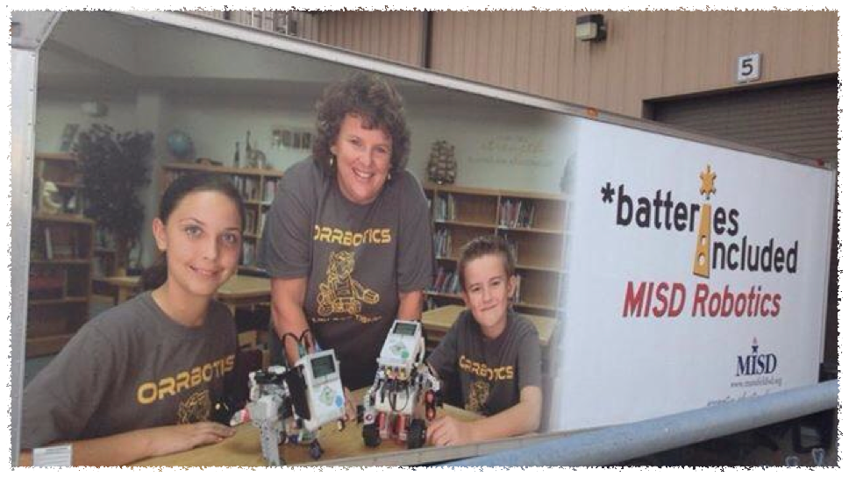

Slide 7
Mansfield ISD Robotics
Pilot program
launched
Implemented WeDo in K-4 Tech Apps
Featured in Mansfield Now
Over 800 students in robotics
2011
2012
2013
2014
2015
2016
2017
2018
Expanded to K-8 campuses
First Team to TCEA State
First Team to FLL Regional Championship

Slide 8
Today’s Agenda
Resources - Google Classroom
Basic Challenges
Build Bot
Advanced Challenges
Programming Overview
Robotics Club Tips & Tricks

Slide 9
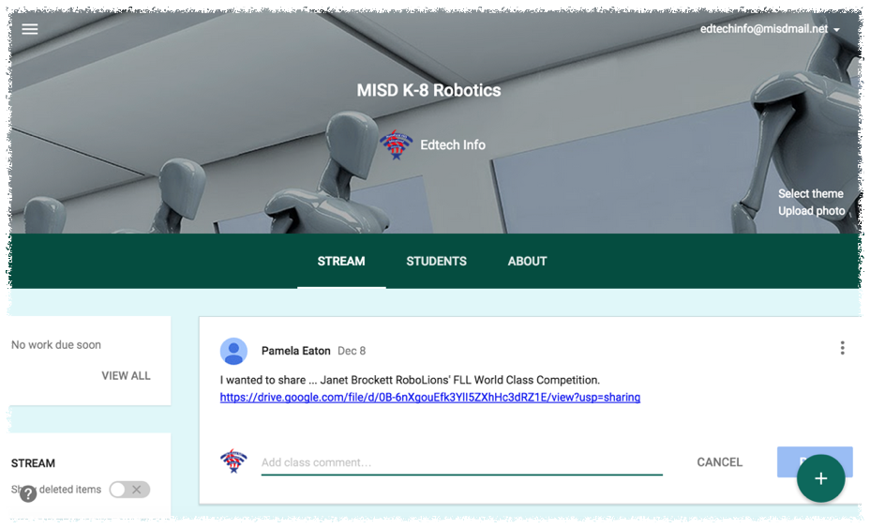

Slide 10
Google Classroom
classroom.google.com
Code: 07zloml

Slide 11
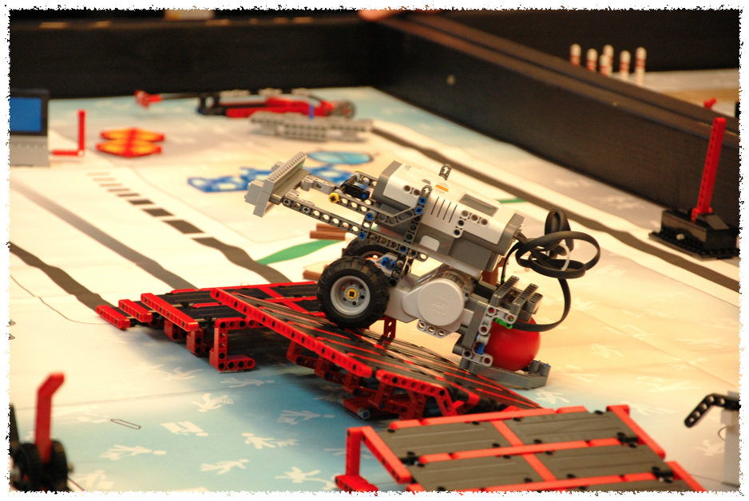

Slide 12
Build Your Bot
Challenge:
You have 30 minutes to build your bot!
Only need Ultrasonic and Color sensors right now.

Slide 13
EV3 Ports
Touch
Arm
Gyro
Drive
Sensors
Motors
Input Ports
Output Ports
Color
Drive
Ultrasonic
Extra

Slide 14
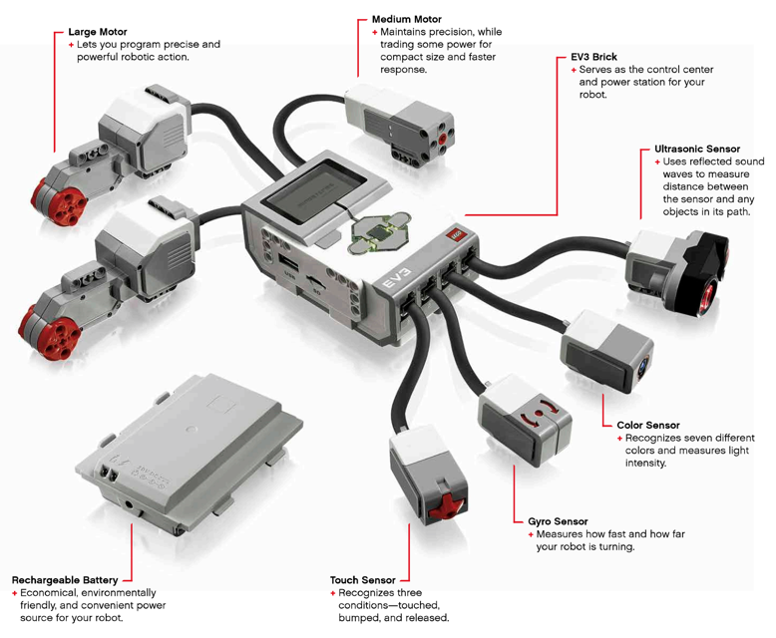
EV3 Ports

Slide 15
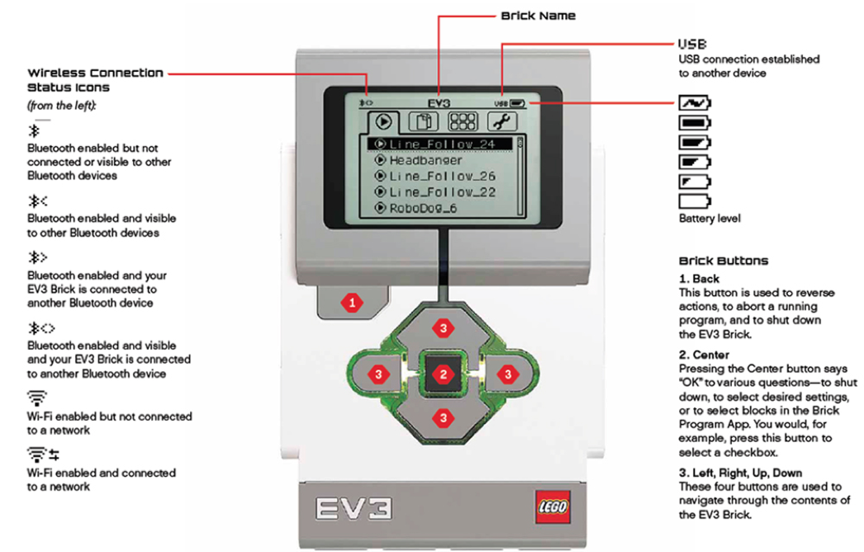
EV3 Interface

Slide 16
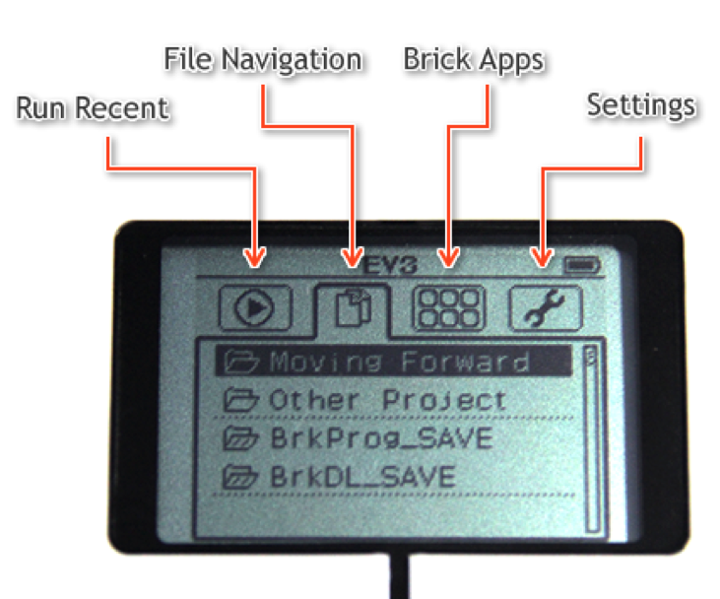
EV3 Interface

Slide 17
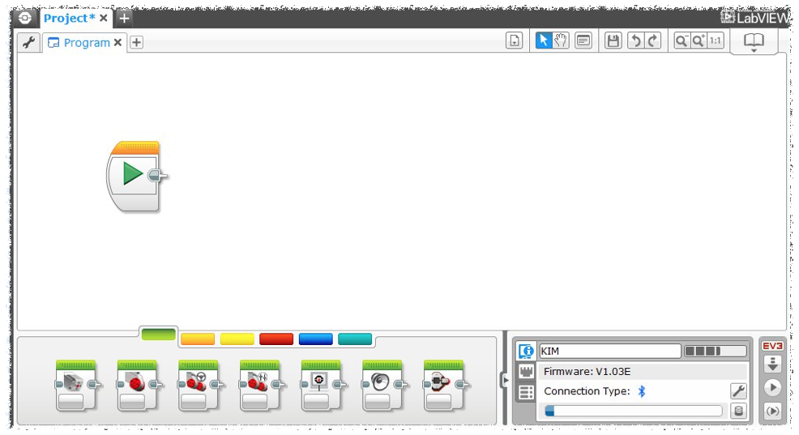

Slide 18
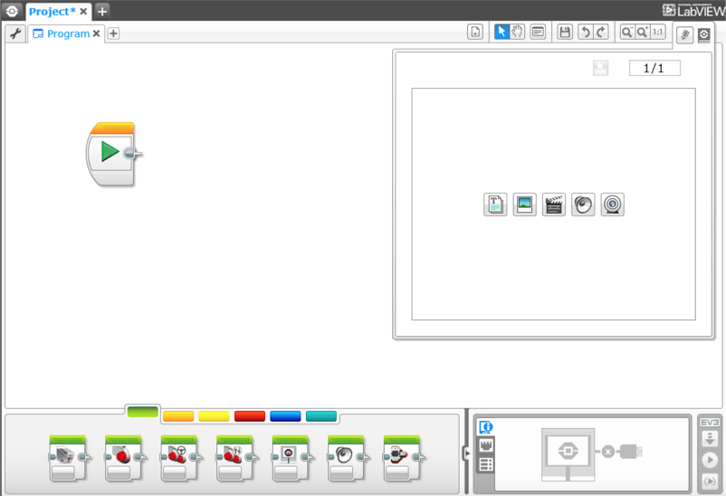
EV3 Programming
Project/Program
Programming Canvas
Content Editor
Palette
Hardware Page

Slide 19
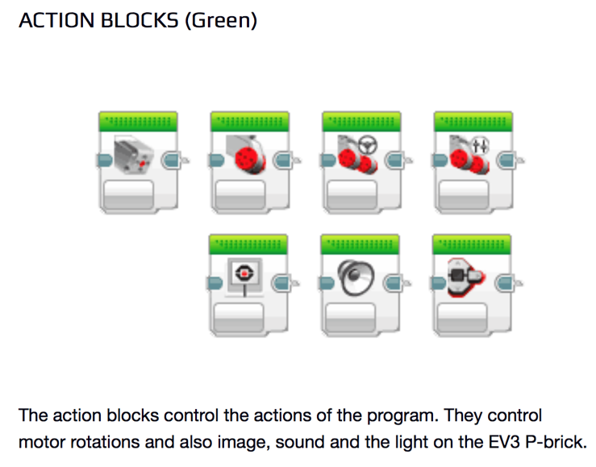
EV3 Programming

Slide 20
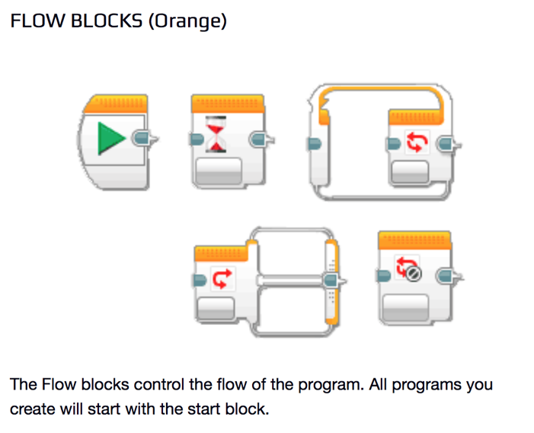
EV3 Programming

Slide 21
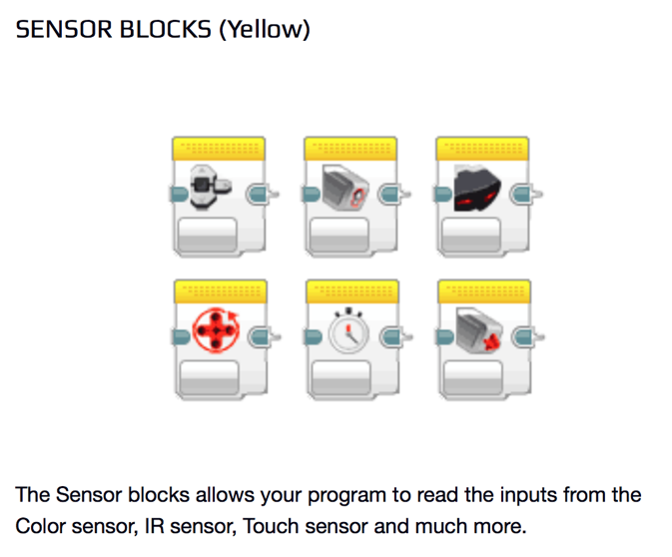
EV3 Programming

Slide 22
EV3 Programming

Slide 23
EV3 Programming

Slide 24
Move Steering
Start Block
Move Steering Block
Motor Ports
Power
Brake
Mode
Steering
# of ________
Notes:
In the move steering block you set a 'steering' value and a single 'power' value (which I think Lego should have called the 'speed' value). The steering value can be set between -100 and +100. With the steering value set at zero the robot will move in a straight line without turning. Set at negative values the robot will turn left, and set at positive values the robot will turn right. Set at -50 or +50 only one wheel will turn and the other will not, giving 'medium' steering. Set at -100 or +100 one wheel will turn forwards and other will turn backwards, so the robot will turn around the midpoint of the wheel axis. The power value can also be thought of as a percentage of full power (or speed). Power can be set positive (go forwards) or negative (go backwards). Often (except when the steering is 100 or -100) the power of each wheel will be different and in these cases the power value refers to the faster-turning wheel.

Slide 25
Move Steering
Left
Straight
Right
Backward
Forward

Slide 26
Move Steering
Left
Straight
Right
Backward
Forward

Slide 27
Move Steering
Rotations
Notes:
'move steering' block with mode set to 'rotations'. The steering value is set to zero, so the robot will move in a straight line, the power is set to +50 so the robot will move forward at 50% power, the number of rotations is set to two and the option to apply the brake after the motion is 'on'. Thus this block will make the robot move two wheel rotations forwards in a straight line

Slide 28
Move Steering
Degrees
Notes:
move steering block with mode set to 'degrees'. The steering value is set to zero, so the robot will move in a straight line, the power is set to -50 so the robot will move backwards at 50% power, the angle is set to 720 degrees (two rotations) and the brake option is 'on'. Thus this block will make the robot move two rotations (of the wheels) backwards in a straight line, bringing the robot back to its starting position. Be clear in your mind that the angle (or number of rotations) refers only to the motors (and the wheels in this case) but NOT THE ROBOT which will turn through some other angle, as seen from above. Note also that setting the power to +50 and the angle to -720° would have had the same effect as in the above program, but that setting both the power and the angle negative would cause the robot to move forwards.

Slide 29
Move Steering
Seconds
Notes:
'move steering' block with mode set to 'seconds'. The steering value is set to zero, so the robot will move in a straight line, the power is set to +50 so the robot will move forward at 50% power, the number of seconds is set to one and the brake option is set on. Thus this block will make the robot move forwards in a straight line at 50% power for one second.

Slide 30
Move Steering
___________ turn to ____________
Hard
right
Notes:
'Move steering' block with mode set to 'degrees'. The steering value is set to +100, so the robot will turn 'hard right', the power is set to +40%, the angle is set to 685° (1.9 rotations) and the brake option is on. Thus this block will make the robot turn hard right until each wheel has turned 1.9 rotations (the left wheel will turn forwards through that angle and the right wheel will turn backwards through the same angle).

Slide 31
Move Steering
____________ turn to ____________
Medium
right
Notes:
'Move steering' block in 'degrees' mode. The steering value is set to 50 so the robot will move make a medium turn right (with the right wheel not turning), the power is set to +40% (for the left wheel), the angle is set to 1380° (3.83 rotations) and the brake option is on. Thus this block will make the robot do a medium turn right, with the left wheel turning 3.83 rotations and the right wheel not turning.

Slide 32
Move Steering
___________ turn to ____________
Slight
right

Slide 33
Move Tank
Start Block
Move Tank Block
Motor Ports
Brake
Mode
# of _______
Power Left
Power Right
Notes:
In the move tank block you set a power value for each motor, or wheel. Set the powers to be equal and the robot will move in a straight line. If power left is set larger (more positive) than power right, then the robot will turn right (clockwise), and vice versa. Setting one wheel to zero power means it will not turn, giving 'medium' turning. Setting the powers at equal and opposite values will make one wheel turn forwards while the other turn backwards, so the robot will turn around the midpoint of the wheel axis.

Slide 34
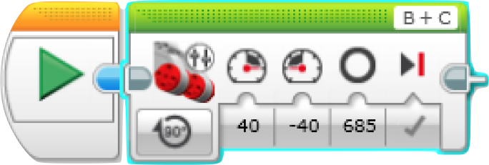
Move Tank
___________ turn to ____________
Hard
right
Notes:
'Move tank' block with mode set to 'degrees'. The 'power left' value is set to +40, and the 'power right' value is set to -40 so the robot will turn 'hard right' at 40% power. The angle is set to 685° so each motor (and wheel) will turn 685° (1.9 rotations) with the left motor turning forwards and the right motor turning backwards. The brake option is on. Thus this block will make the robot turn hard right with each wheel turning through 1.9 rotations.

Slide 35
Move Tank
_____________ turn to ____________
Medium
right
Notes:
'Move tank' block in 'degrees' mode. The 'power left' value is set to +40, and the 'power right' value is set to zero so the robot will turn 'medium right' with the left wheel at 40% power and the right wheel not turning. The angle is set to 1380° so the left motor (and wheel) will turn 1380° (3.83 rotations). The brake option is on. Thus this block will make the robot turn medium right with the wheel block turning 3.83 rotations and the right wheel not turning.

Slide 36
Move Tank
_____________ turn to ____________
Gentle
left
Notes:
Move tank' block in 'rotations' mode. The 'power left' value is set to +25, and the 'power right' value is set to +50 so the robot will turn 'gentle left’ with the left wheel at 25% and the right wheel at 50% power. The number of rotations is set to two so the left motor (and wheel) will turn two rotations (the right wheel will turn 1 rotation, if you think about it). The brake option is on.

Slide 37
Basic Challenges
Just Make It Go!
Clean Getaway
Perfect Square
Going the Distance
Drive 3 feet forward - use rotations, degrees, and seconds!
Drive 3 feet forward slowly, pause for 2 seconds, and then reverse quickly back to starting point
Drive robot in a square with 4 point turns
Hint - use a loop!
Drive robot to go exactly 10 feet (from line to line)
20 pts
30 pts
40 pts
50 pts

Slide 38
The Race is On!
10-yd Dash
5 yards forward, 180-degree turn, and 5 yards back
(must cross line completely before turnaround)
100 pts
75 pts
50 pts

Slide 39
Advanced Challenges
Stop Light
Follow the
Line
Parking
Lot
Mountain
Climbing
Catapult
Use light sensor to follow zig zag line
Program robot to park in random parking spot
Redesign your bot to climb different levels of incline
Using the ultrasonic sensor, program bot to stop before it hits a wall
Add an auxiliary motor to catapult a hacky sack as far as possible
10 pts per inch
40 pts per level
75 pts
100 pts
150 pts

Slide 41
Myths Debunked
You need to know everything about robotics
You need to
know everything about competition
You need an aptitude for math/
engineering
You need to
know more than your students
Your students
need to be
Gifted & Talented
Boys are better than girls at robotics

Slide 42
Selection Process
Limit number of students (base on # of kits)
Challenging application
Teacher recommendation
Maintain good grades and citizenship

Slide 43
Countdown Begins
Week 1 - Introduction, Expectations, Terminology
Week 2 - Build simple Taskbot
Week 3 - Intro to Programming
Week 4 - Basic Challenges
Weeks 5/6 - Advanced Challenges
Week 7 - Start TCEA/FLL Preparations

Slide 44
Tips for Success
Competitions - just do them!
Set clear expectations and rules
Get parents involved
YouTube is your best friend!
Have fun!

Slide 45
Lessons Learned
Get started early!
Register for competitions and order materials as soon as they are available
Read the rules CAREFULLY!

Slide 46
Lessons Learned
Get started early!
Register for competitions and order materials as soon as they are available
Read the rules CAREFULLY!

Slide 47
Thank you for attending
Getting Started
Robotics
with
Get the presentation:
bit.ly/GettingStartedwithRobotics

