Slide 1
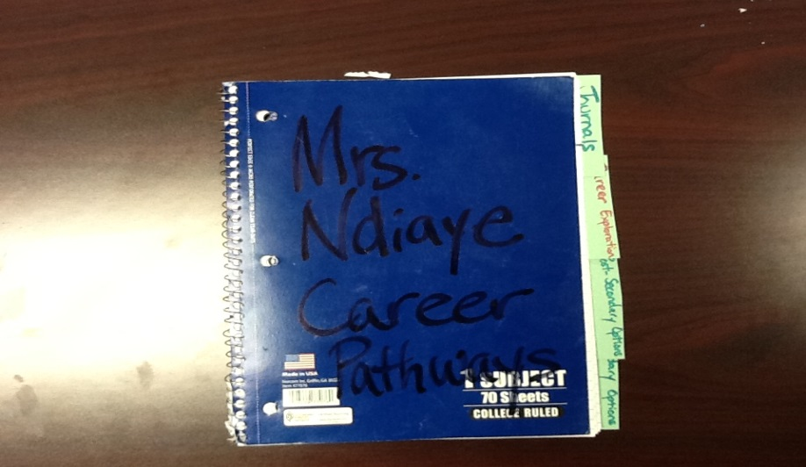
Setting Up Our Interactive Student Notebooks

Slide 2
What is the purpose?
Interactive notebooks promote organization, engage students, and encourage students (YOU!):
to process information
combine words and visuals
become a working portfolio
and demonstrate critical thinking.
Interactive notebooks are a major grade each six weeks.

Slide 3
What Are Some Things That Will Go Inside My Notebook?
Responses to Daily Journals
Foldables
Brainstorming
Graphic Organizers
Cornell Notes
Lecture Notes
Class Handouts
Questions
Vocabulary
Articles
Movie, video notes
Flow charts
Venn diagram
T-charts
Cartoons
…..basically everything!

Slide 4
The Process
Left Side
Teacher Provides New Information
Class/Discussion Notes
Reading Notes
Handouts With Information
Right Side
Student Processes New Information
Reorganize new information into creative format
Expresses opinions and feelings
Explore New Ideas

Slide 5
Materials Needed
We will create our tabs, table of contents, number the pages, and glue our cheat sheet inside.
Spiral Notebook
Glue stick or Glue
Strip of Construction Paper
Colored Pencils or Markers
Cheat Sheet of Classroom Web Codes Handout

Slide 6
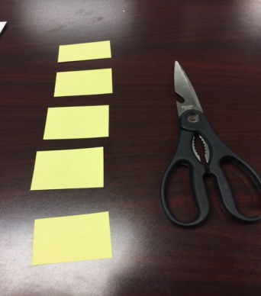
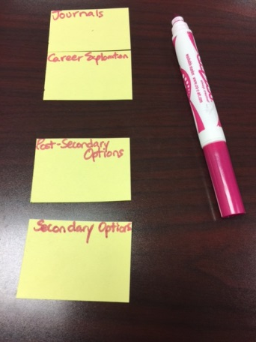
Creating Our Tabs
To Create Four Tabs:
Begin by creating your tabs. Cut the strip of construction paper into four pieces.
Write each name at the very top of each strip. Using a marker or colored pencil will work best.
Journals
Career Exploration
Post-Secondary Options
Secondary Options
Set these to the side. You will eventually glue them inside of your journal.

Slide 7
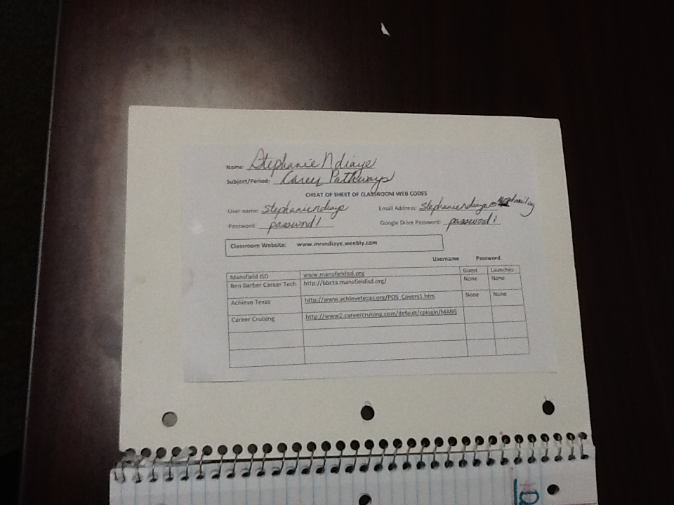
The Inside Front Cover
Glue your Cheat Sheet of Classroom Web Codes.

Slide 8
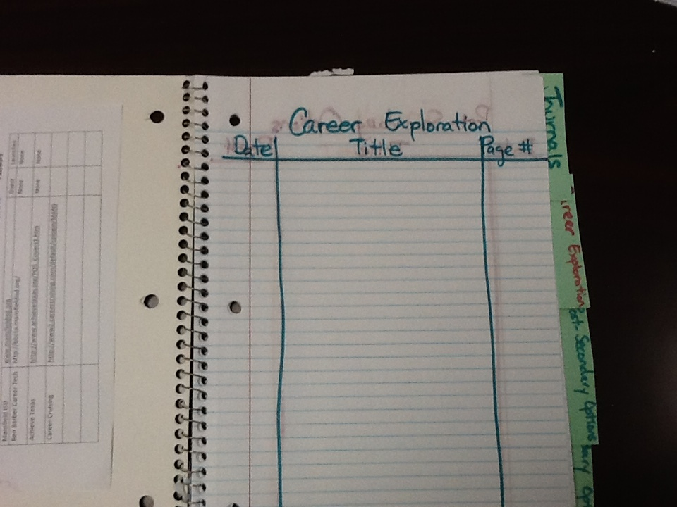
Table of Contents
First FOUR pages of our journal will be the table of contents.
Each page will be labeled - date, title, and page #
Create three columns, as seen below.

Slide 9
Career Exploration
Write “Date” in the left margin. Write “Title” in the center. Write “Page #” in the right margin. Draw the lines to distinguish the columns.

Slide 10
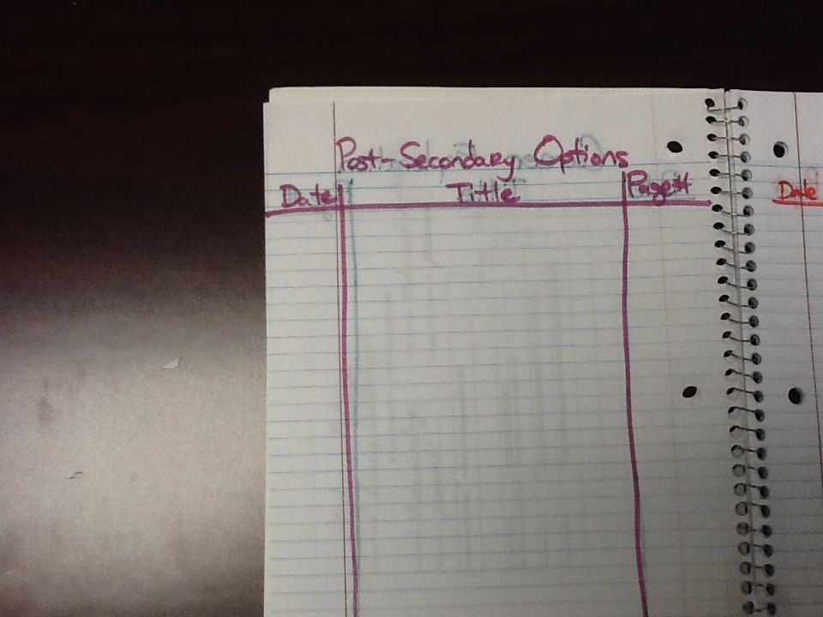
Post-Secondary Options
Write “Date” in the left margin. Write “Title” in the center. Write “Page #” in the right margin. Draw the lines to distinguish the columns.

Slide 11
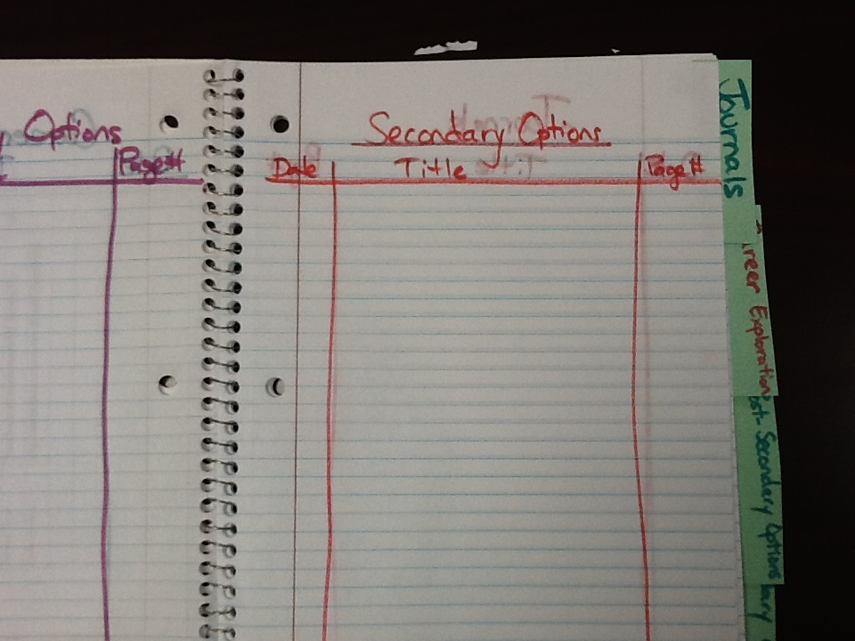
Secondary Options
Write “Date” in the left margin. Write “Title” in the center. Write “Page #” in the right margin. Draw the lines to distinguish the columns.

Slide 12
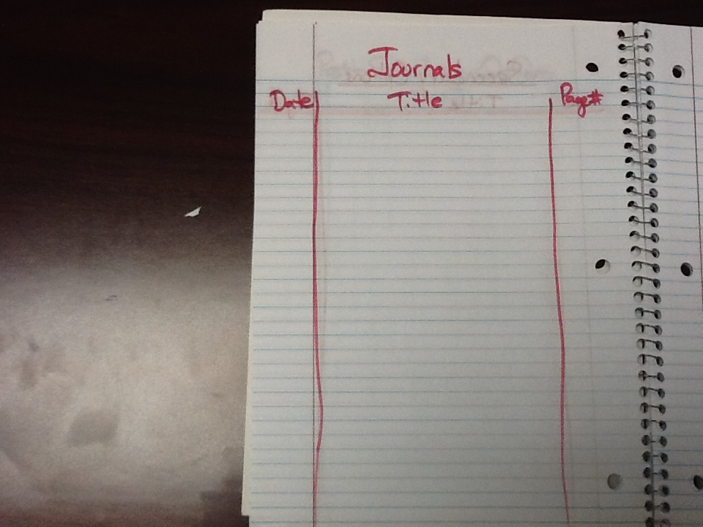
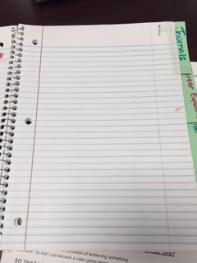
Journals
Write “Date” in the left margin. Write “Title” in the center. Write “Page #” in the right margin. Draw the lines to distinguish the columns.
Leave the right page blank. This will become the TITLE Page.

Slide 13
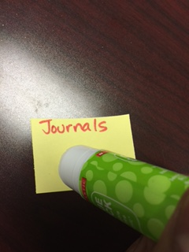
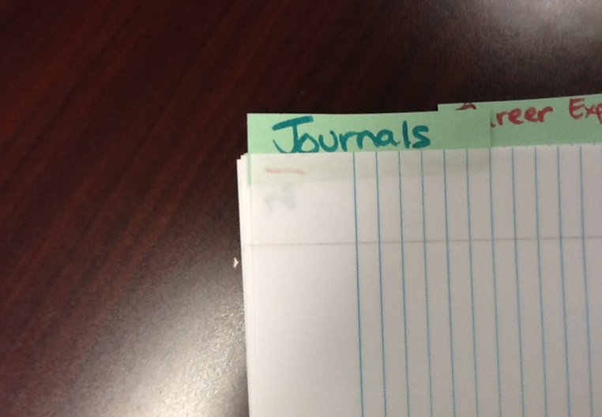
Gluing TABS
1. Put the glue UNDER the words you wrote on the tab.
2. Glue the “Journals” tab to the back of the blank page.

Slide 14
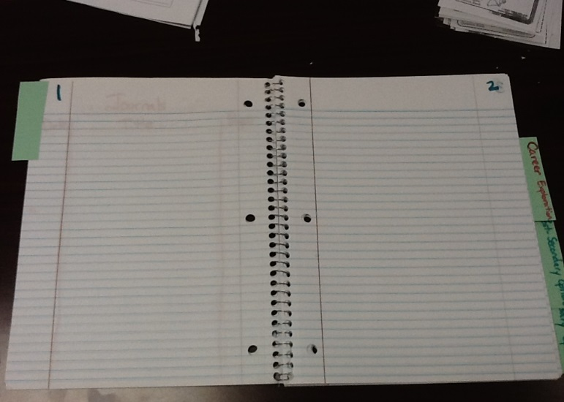
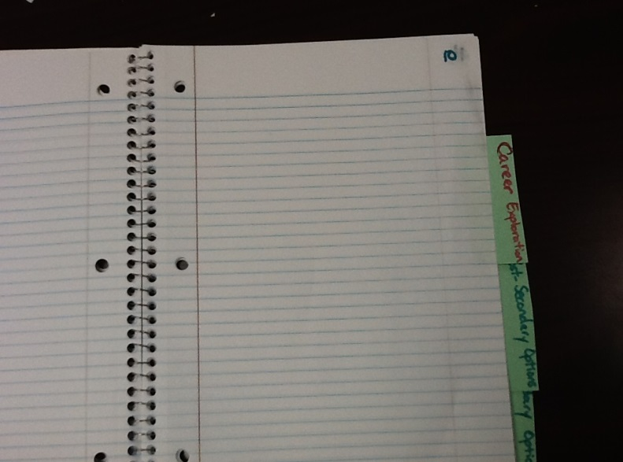
Number your Pages
Starting with the backside of the blank page.
Start with number 1
Number the first 10 pages
Odd pages will be on the left-hand side.
Even pages will be on the right-hand side.
On the back of page 10, glue the “Career Explorations” tab.

Slide 15
Number your Pages
Starting with the backside of the “Career Explorations” tab.
Start with number 11
Number the next pages 11-30
Odd pages will be on the left-hand side.
Even pages will be on the right-hand side.
On the back of page 30, glue the “Post-Secondary Options” tab.

Slide 16
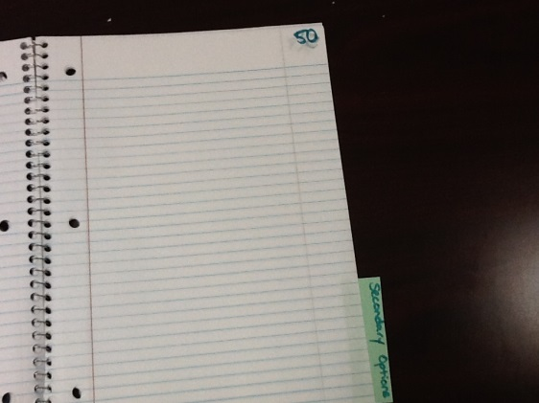
Number your Pages
Starting with the backside of the “Post-Secondary” tab.
Start with number 31
Number the next pages 31-50
Odd pages will be on the left-hand side.
Even pages will be on the right-hand side.
On the back of page 50, glue the “Secondary Options” tab.

Slide 17
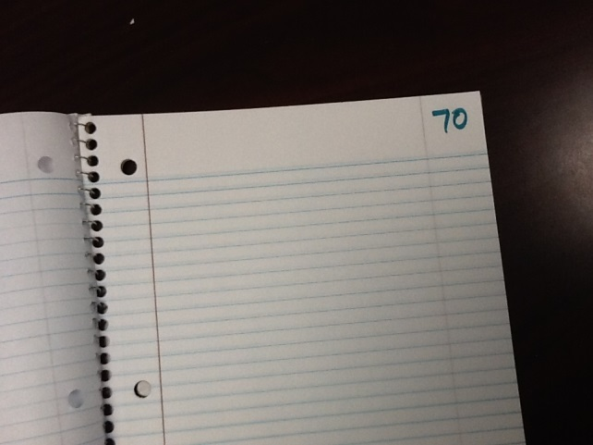
Number your Pages
Starting with the backside of the “Secondary Options” tab.
Start with number 51
Number the next pages 51-70
Odd pages will be on the left-hand side.
Even pages will be on the right-hand side.
Stop at page 70.
We will leave the remaining pages for future use, if needed.

Slide 18
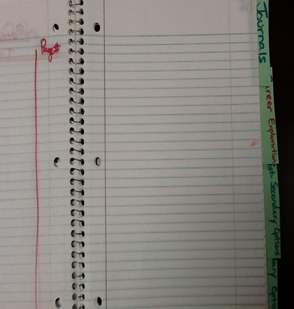
Set Up is Finished! Let’s add a few pages.

Slide 19
Go to the “Secondary Options” Table of Contents
Add the following entries:
Date | Title | Page #
01/28/15 | Foundation High School Plan | 51
02/04/15 | Endorsement Project Cornell Notes | 52

Slide 20
Glue to Page 51
Foundation High School Plan foldable.
Cut out the lime (or orange) sheet to fit the page.
Glue the sheet onto page 51.

Slide 21
Page 52
We will glue our Endorsement Cornell Notes to this page.
Please watch how I do it!

